Slide 1


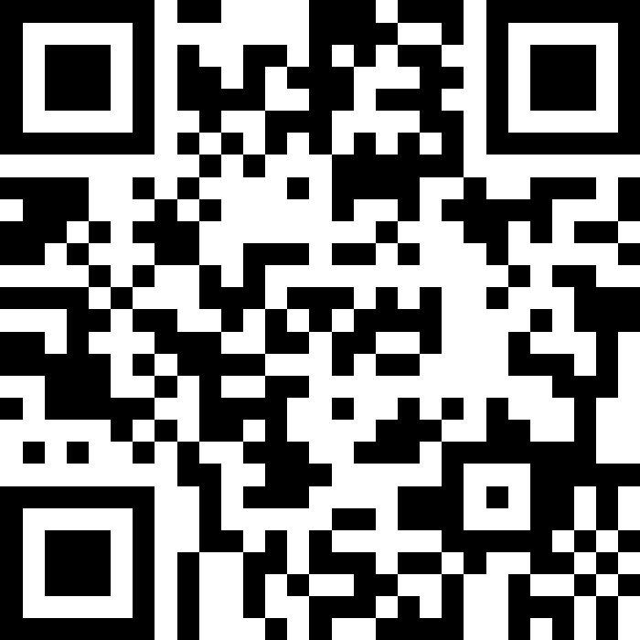
自然語言處理與應用 Natural Language Processing and Applications
NLG Evaluations (Learning-based)
Instructor: 林英嘉 (Ying-Jia Lin)
2025/05/26
Course GitHub
Slido # NLP_0526

Slide 2

Phases for Building a Machine Learning Model
Data-preprocessing
Model Training
Evaluations
Metrics

Slide 3
[Recap] How to evaluate natural language generation?
Natural language is hard to evaluate due to subjectivity and language diversity.
For example: Machine Translation
我
愛
閱
讀
I
love
reading
books
(Source language)
我
愛
讀
書
(Target language)
Human evaluations
Automatic evaluations (We will focus on this topic.)

Slide 4
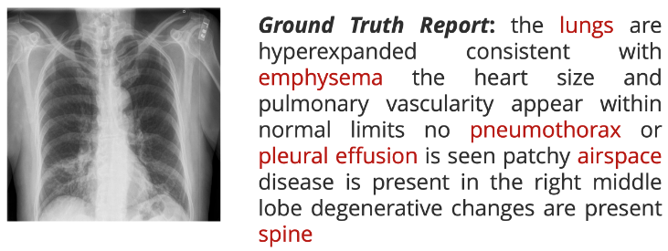
Medical Report Example
Model Generated report
There is hyperexpansion of the lungs indicating emphysema.
The heart and pulmonary vessels are within normal limits.
No signs of pneumothorax or pleural effusion.
Airspace disease affects the right middle lobe.
Degenerative spinal changes are noted.
Is this good?
https://arxiv.org/abs/2409.00250

Slide 5
Evaluations
Perplexity
BLEU Score
ROUGE Score
BERTScore
BLEURT
Mauve
Rule-based (model-free)
Learning-based
(model-based)

Slide 6
Issue of BLEU and ROUGE
Pros: 採用 tokens 重疊率，容易實作
Cons: Cannot meet language diversity
This mainly comes from the way for measuring overlapping rates.
Question: Can we create an automatic metric to fix the issue?
Next, we are going to introduce two learned automatic evaluation metrics
BERTScore (ICLR 2020)
BLEURT (ACL 2020)

Slide 7
(Recap) BERT: Bidirectional Encoder Representations from Transformers
BERT was pre-trained with MLM and NSP objectives.
Masked Language Modelling (MLM)
Next Sentence Prediction (NSP)
bank
binary classification
BERT
(Contexual Embedding)
BERT
(Contexual Embedding)
[CLS]
open
a
[mask]
account
[SEP]
[CLS]
study
hard
[SEP]
please
[SEP]
Devlin, Jacob, et al. "BERT: Pre-training of Deep Bidirectional Transformers for Language Understanding." NAACL 2019.

Slide 8
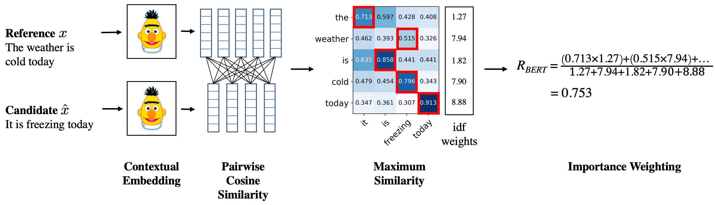
BERTScore – Overview
Zhang, Tianyi, et al. "BERTScore: Evaluating Text Generation with BERT." International Conference on Learning Representations. 2020.

Slide 9

BERTScore 使用範例
🙋
How’s the weather today?
It is freezing today.
Candidate
BERTScore
95%
The weather is cold today.
Reference
代表生成的結果與
標準答案的語意相似性

Slide 10
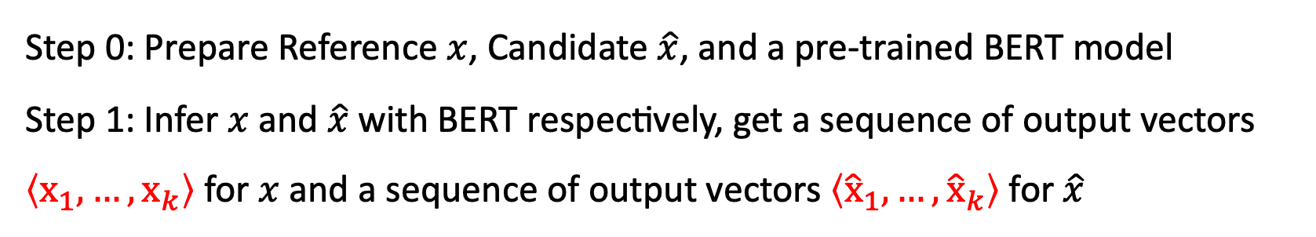
BERTScore – Steps
Step 0: Prepare Reference $x$, Candidate $\hat{x}$, and a pre-trained BERT model
Step 1: Infer $x$ and $\hat{x}$ with BERT respectively, get a sequence of output vectors $\left\langle {\text{x}}_{1}, …, {\text{x}}_{k}\right\rangle$ for $x$ and a sequence of output vectors $\left\langle {\hat{\text{x}}}_{1}, …, {\hat{\text{x}}}_{k}\right\rangle$ for $\hat{x}$
Zhang, Tianyi, et al. "BERTScore: Evaluating Text Generation with BERT." International Conference on Learning Representations. 2020.

Slide 11
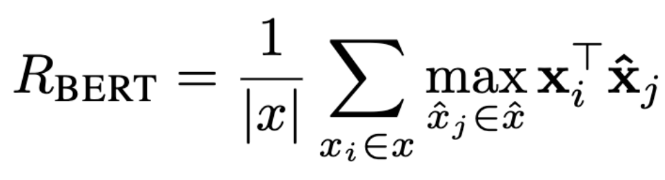
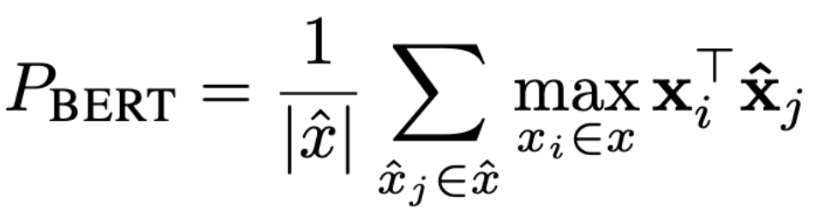
BERTScore – Steps
Zhang, Tianyi, et al. "BERTScore: Evaluating Text Generation with BERT." International Conference on Learning Representations. 2020.
Step 2: Measure pairwise cosine similarity
Refence
(這裡紅框為Recall算法)
Candidate
Recall
以 Reference tokens 的分數取最大值
Based on reference
Precision
以 Candidate tokens 的分數取最大值
Based on candidate

Slide 12
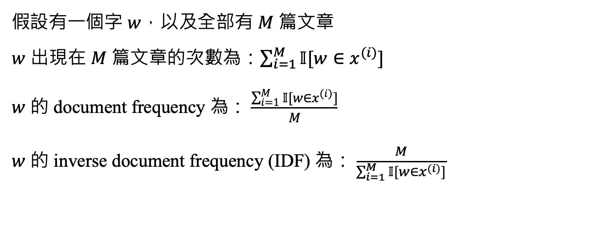
Importance Weighting (罕見字的影響)
我今天喝了一杯咖啡。
我今天喝了一杯抹茶拿鐵。
我今天去路易莎。
IDF(今天) = 3/3 = 1
IDF(抹茶拿鐵) = 3/1 = 3
假設有一個字 $w$，以及全部有 $M$ 篇文章
$w$ 出現在 $M$ 篇文章的次數為：$\sum_{i=1}^{M}{𝕀[w∈x^{(i)}]}$
$w$ 的 document frequency 為： $\frac{\sum_{i=1}^{M}{𝕀[w∈x^{(i)}]}}{M}$
$w$ 的 inverse document frequency (IDF) 為： $\frac{M}{\sum_{i=1}^{M}{𝕀[w∈x^{(i)}]}}$

Slide 13
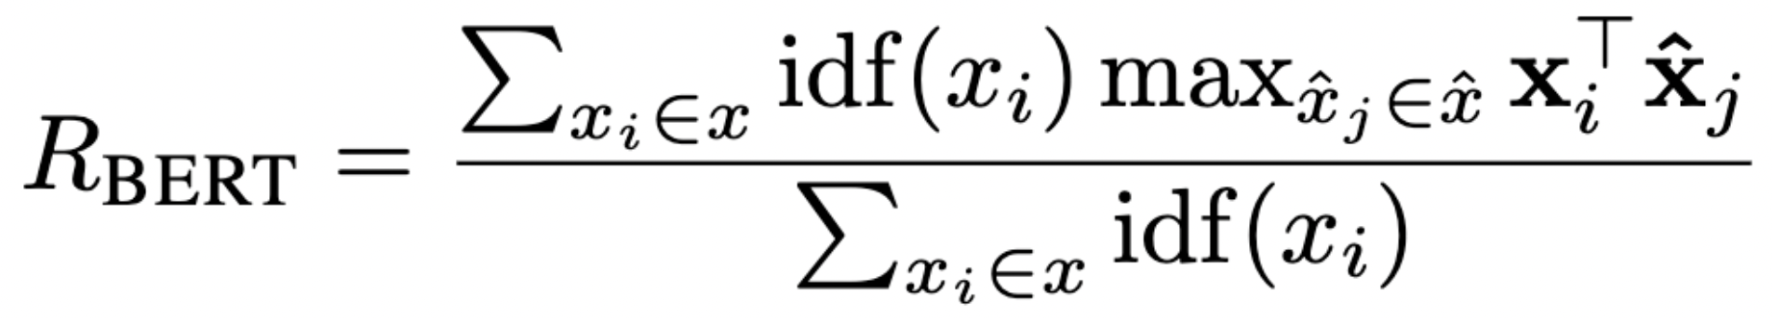
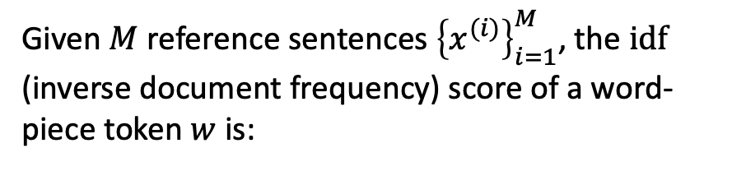
BERTScore – Importance Weighting
Given $M$ reference sentences ${\left\{x^{(i)}\right\}}_{i=1}^{M}$, the $\text{idf}$ (inverse document frequency) score of a word-piece token $w$ is:
Zhang, Tianyi, et al. "BERTScore: Evaluating Text Generation with BERT." International Conference on Learning Representations. 2020.

Slide 14
Summary of BERTScore
BERTScore leverages the contextual representation abilities of BERT to measure the semantic similarities between a reference and a candidate.
In the original paper, BERTScore correlates better with human judgments and provides stronger model selection performance than existing metrics.
However, BERTScore does not involve training process.
Can we train BERT for a better evaluation metric?
Zhang, Tianyi, et al. "BERTScore: Evaluating Text Generation with BERT." International Conference on Learning Representations. 2020.

Slide 15
BLEURT – Quick Introduction
BLEURT: Learning Robust Metrics for Text Generation, published by Google
BLEURT trains BERT for a more robust evaluation metric.
Mainly for machine translation.
Also get hints from the name “BLEURT”
Trained checkpoint can be obtained. We don’t need to perform training.
Sellam, Thibault, Dipanjan Das, and Ankur Parikh. "BLEURT: Learning Robust Metrics for Text Generation." Proceedings of the 58th Annual Meeting of the Association for Computational Linguistics. 2020.

Slide 16
BLEURT – Motivations
With human ratings, learned metrics can be tuned to measure task-specific properties, such as fluency, faithfulness, grammar, or style.
NLG systems tend to get better over time, and therefore a model trained on ratings data from 2015 may fail to distinguish top performing systems in 2019, especially for newer research tasks.

Slide 17
Training on Human Ratings
Traditional
Reference
BLEU
BLEU score
Candidate
Learning
Mean squared error (regression loss)
Reference
Training
Human Rating
Model
Predicted Rating
Candidate
Reference
Trained Model
Inference
Predicted Rating
Candidate

Slide 18
BLEURT 前情提要
BLEURT 是一個 BERT (以英文BERT初始化)
BLEURT 有 pre-training 跟 fine-tuning
fine-tuning: 學習人類的打分
pre-training: 使用 data augmentation 在非打分任務上面進行暖身 (warm-up, for transfer learning)

Slide 19
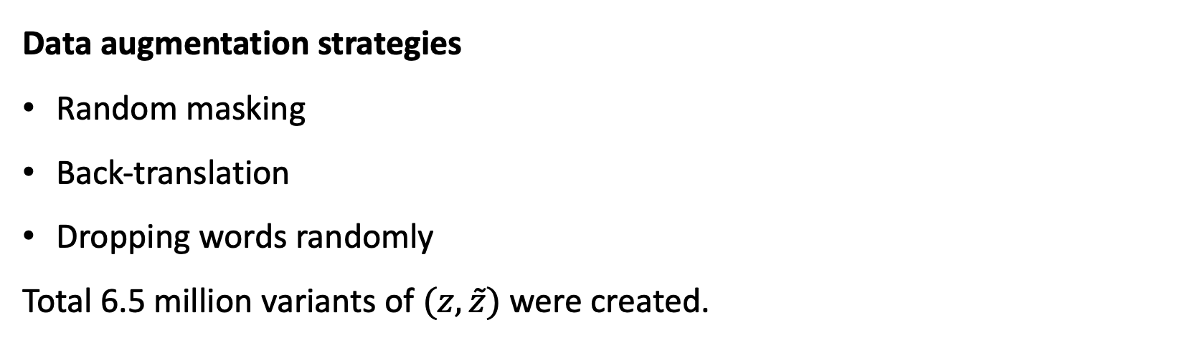
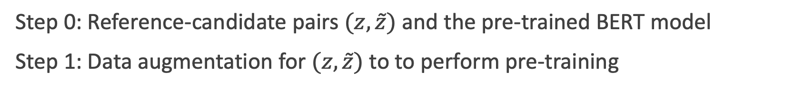
BLEURT – Steps
Step 0: Reference-candidate pairs $(z,\tilde{z})$ and the pre-trained BERT model
Step 1: Data augmentation for $(z,\tilde{z})$ to to perform pre-training
Data augmentation strategies
Random masking
Back-translation
Dropping words randomly
Total 6.5 million variants of $(z,\tilde{z})$ were created.
Sellam, Thibault, Dipanjan Das, and Ankur Parikh. "BLEURT: Learning Robust Metrics for Text Generation." Proceedings of the 58th Annual Meeting of the Association for Computational Linguistics. 2020.

Slide 20
Random masking (for pre-training)
Two kinds of masking strategies were adopted:
Token masking
I love traveling to Vancouver for attending a conference.
I love traveling to Vancouver for [MASK] a conference.
Span masking
I love traveling to Vancouver for attending a conference.
I love traveling to Vancouver for [MASK] [MASK] [MASK].

Slide 21
Backtranslation (for pre-training)
For example: L1 -> English; L2 -> French or German
L1 sentence
MASS encoder
(L1 embedding)
MASS decoder
(L2 embedding)
L2* sentence
～
L1* sentence
MASS decoder
(L1 embedding)
MASS encoder
(L2 embedding)

Slide 22
Dropping words randomly (for pre-training)
The authors found it useful in their experiments to randomly drop words to create other examples.
I love traveling to Vancouver for attending a conference.
I love to Vancouver for attending a conference.
Sellam, Thibault, Dipanjan Das, and Ankur Parikh. "BLEURT: Learning Robust Metrics for Text Generation." Proceedings of the 58th Annual Meeting of the Association for Computational Linguistics. 2020.

Slide 23
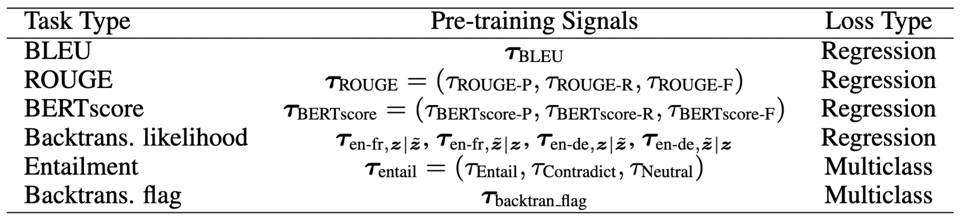
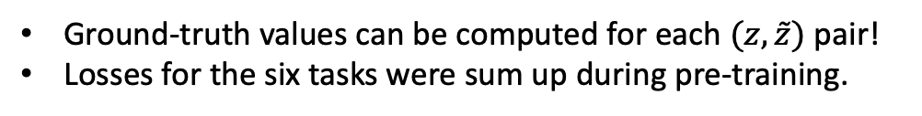
BLEURT – Step 3 (for pre-training)
Step 3: Pre-training each sentence pair $(z,\tilde{z})$ with the following tasks.
Note that this is not conventional BERT pre-training! It is multi-task pre-training!
Ground-truth values can be computed for each $(z,\tilde{z})$ pair!
Losses for the six tasks were sum up during pre-training.
Regression: mean squared error
Multiclass: Cross-entropy
Sellam, Thibault, Dipanjan Das, and Ankur Parikh. "BLEURT: Learning Robust Metrics for Text Generation." Proceedings of the 58th Annual Meeting of the Association for Computational Linguistics. 2020.

Slide 24
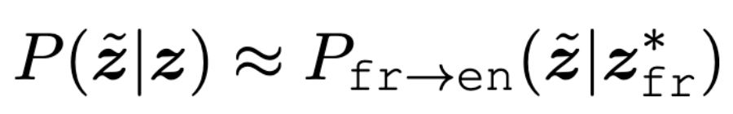
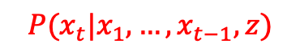
Task 4: Backtranslation Likelihood
Existing FOUR translation models (trained) are needed.
Transformers (Vaswani et al., 2017): EN-FR, FR-EN
Transformers (Vaswani et al., 2017): EN-DE, DE-EN
Equations use EN-FR for an example
$$P(x_{t}|x_{1},…,x_{t−1}, z)$$
Best translated French sentence (details absent in the paper)
Backtranslation Likelihood

Slide 25


Task 4: Backtranslation Likelihood
先翻到法文，再翻回英文
先翻到德文，再翻回英文
使用第二組的結果
先翻到法文
再翻回英文原句
使用第四組的結果
先翻到德文
再翻回英文原句
符號提醒：z跟波浪z都是同語言
[CLS]
$$z$$
[SEP]
$$\tilde{z}$$
[SEP]
BERT

Slide 26
Task 5 and Task 6
Textual Entailment
We report the probability of three labels: Entail, Contradict, and Neutral, using BERT fine-tuned on the MNLI dataset.
Backtranslation flag
A Boolean that indicates whether the perturbation was generated with backtranslation or with mask-filling (例如替換 tokens).

Slide 27
BLEURT – Final Step
Step 4: Fine-tune the model (trained from Step 3) on the <Reference, Candidate, Rating> data using the regression loss (Mean squared error)
The <Reference, Candidate, Rating> data include
WMT (machine translation task)
WebNLG (for general text generation)
semantics, grammar, and fluency
人類的打分

Slide 28
Summary of BLEURT
This approach uses (continual) pre-training and fine-tuning to create a learned evaluation metric for machine translation and general NLG.
According to the paper, BLEURT is better aligned to human ratings then BERTScore.
BLEURT should work for text summarization, but the authors did not test it.
Sellam, Thibault, Dipanjan Das, and Ankur Parikh. "BLEURT: Learning Robust Metrics for Text Generation." Proceedings of the 58th Annual Meeting of the Association for Computational Linguistics. 2020.

Slide 29
Comparison for Human and Automatic Evaluations (e.g., BLEU and ROUGE)
Human evaluations
Pros: More accurate for subjectivity, flexibility for any desired comparison
Cons: Less objective, time-consuming, expensive
Automatic evaluations
Pros: Objective enough to serve as common evaluation metrics, fast
Cons: Cannot meet language diversity
Take machine translation for instance, there are always other valid ways to translate the source sentence.

Slide 30
GPTRank
You will be given a news article along
with two summaries. Please compare
the quality of these two summaries and
pick the one that is better (there can be a
tie). First you will give an explanation of
your decision then you will provide your
decision in the format of 1 or 2 or tie.
https://aclanthology.org/2024.naacl-long.478
🙋
Response format:
Explanation: “Your explanation here”.
Decision: 1 or 2 or tie.
Here’s the article:
{{Article}}
Summary 1:
{{Summary 1}}
Summary 2:
{{Summary 2}}
...

Slide 31
Thank you!
Instructor: 林英嘉
✉️ yjlin@cgu.edu.tw

